Slide 1
Algorithms and Data Structures
Binary Heap

Slide 2

Contents
Introduction to Binary Heap
Implementation
Properties of MinHeap
Operations of MinHeap
  Building a MinHeap
  Heapify
  Insert a new element into minHeap
  Delete minimum element from minHeap

Slide 3
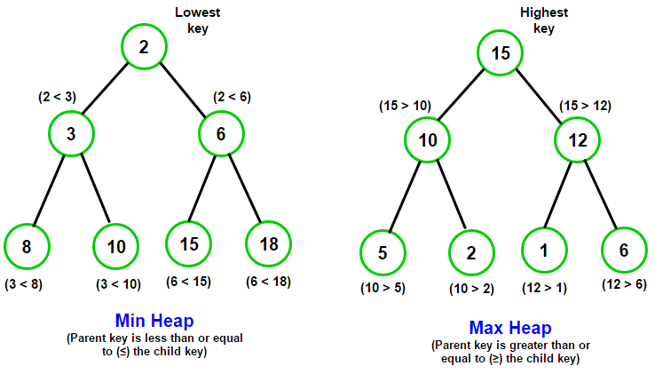
Binary Heap
A Binary Heap is a specialized binary tree with following properties:
  A binary heap is a complete binary tree, meaning all levels are fully filled except possibly the last one, which is filled from left to right.
    This property of Binary Heap makes them suitable to be stored in an array.
  A Binary Heap is either Min Heap or Max Heap.
    Min Heap: The value of each node is less than or equal to the values of its children. The smallest value is always at the root.
    Max-Heap: The value of each node is greater than or equal to the values of its children. The largest value is at the root.

Slide 4
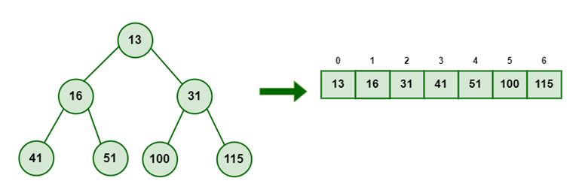
Implementation
Commonly implemented using arrays.
Takes advantage of the complete binary tree property.
Node | 13 | 16 | 31 | 41 | 51 | 100 | 115
index (i) | 0 | 1 | 2 | 3 | 4 | 5 | 6
Parent (i-1)/2 | root, no parent | 0 | 0 | 1 | 1 | 2 | 2
index of Left 2i+1 | 1 | 3 | 5 | - | - | - | -
index of Right 2i+2 | 2 | 4 | 6 | - | - | - | -
Array provides efficient Parent-Child Indexing
For a node at index i
  Parent is available at index (i−1)/2
  LeftChild is available at index 2i+1
  RightChild is available at index 2i+2

Slide 5
MinHeap as ADT
Attributes
  heap: array to store elements of heap
  size: Number of elements in heap
  maxSize: Number of elements in heap
Operations
  buildMinHeap
    heapify
  insert
  delete

Slide 6
heapify
A heapify operation can be used to create a min heap from an unsorted array.
This process begins at the root, where swaps are performed with its children as necessary to ensure the heap property is satisfied. The "bubble down" operation is then repeatedly applied until all nodes in the heap comply with the heap property.
i
left
8
2
right
2
4
3
4
5
3
9
6
5
8
9
6
10
7
10
7

Slide 7
heapify Illustration
i
i
left
8
8
right
left
right
2
4
2
4
5
3
9
6
5
3
9
6
10
7
10
7
min value is at left
swap values at i and left
i
2
2
left
8
4
3
4
5
3
9
6
5
8
9
6
10
7
right
10
7
i
min value is at right
swap values at i and right
i is leaf

Slide 8
heapify
Pseudocode Heapify(heap, i)
// heap is an array of integers, i is the index where heapify starts
left = 2*i + 1;
right = 2*i + 2;
min=findMin(i, left, right) // min has the index of minimum value
if (min != i) // If the smallest is not the root, swap and heapify the affected subtree
swap heap[i] with heap[min]
Heapify(heap, min); // Recursively heapify the affected subtree
end if
end Heapify

Slide 9

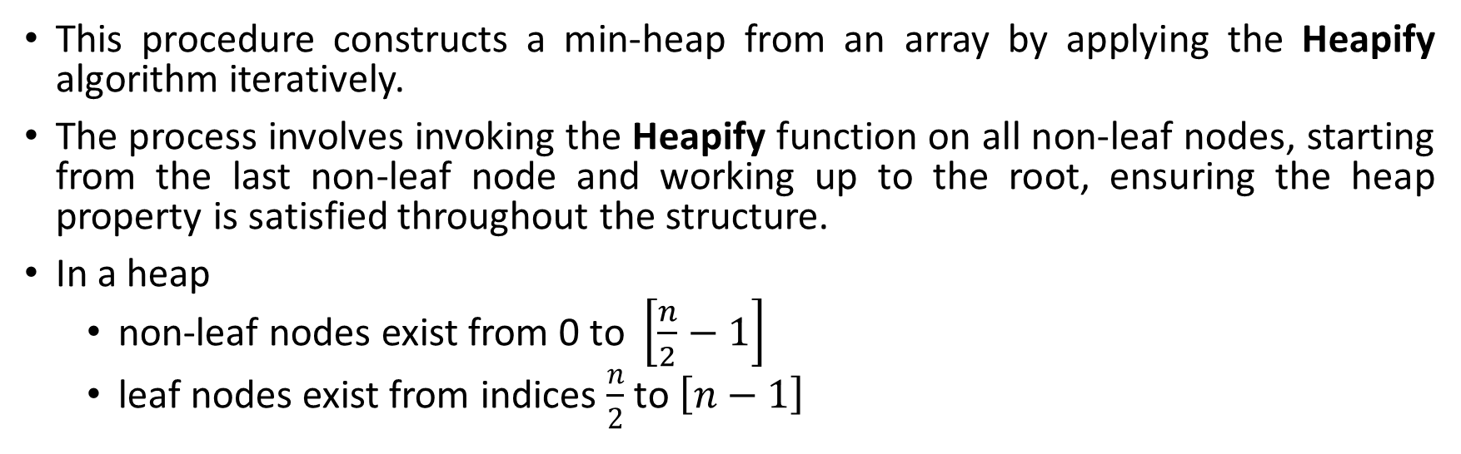
buildMinHeap
This procedure constructs a min-heap from an array by applying the Heapify algorithm iteratively.
The process involves invoking the Heapify function on all non-leaf nodes, starting from the last non-leaf node and working up to the root, ensuring the heap property is satisfied throughout the structure.
In a heap
  non-leaf nodes exist from 0 to $\left[\frac{n}{2}−1\right]$
  leaf nodes exist from indices $\frac{n}{2}$ to $\left[n−1\right]$
2
0
3
1
4
2
5
3
4
8
9
5
6
6
Pseudocode buildMinHeap(heap)
for (int i = (n/2)-1; i >=0; i--)
Heapify(heap,i);
end for
end buildMinHeap
10
7
7
8
n=9
non-leaf nodes indices : 0 to 3
leaf nodes indices : 4 to 8

Slide 10
Insert an element into minHeap
Place the new element at the last of the heap
Bubble Up:
  Compare the inserted element with its parent.
  Swap the inserted element with its parent if it violates the min-heap property (i.e., the parent is larger than the child).
  Repeat this process until the heap property is restored or the inserted element becomes the root.
2
3
4
5
8
9
15
10
7
new

Slide 11
Insert an element into minheap
Example 1
2
2
Insert the element 1
3
4
3
4
5
8
9
15
5
8
9
15
10
7
1
10
7
1
2
2
1
3
4
1
4
2
4
5
1
9
15
5
3
9
15
5
3
9
15
10
7
8
10
7
10
7
8
8

Slide 12
Insert an element into minheap
Example 2
Insert the element 6
2
2
2
3
4
3
4
3
4
5
8
9
15
5
8
9
15
5
6
9
15
10
7
6
10
7
6
10
7
8

Slide 13
insert
Pseudocode insert(element)
if(size<=maxSize)
heap[size++] = element;
BubbleUp(size-1); // last element is at index of size-1
end insert
BubbleUp(index)
while (index > 0)
parentIndex = (index - 1) / 2;
if (heap[index] >= heap[parentIndex])
break;
Swap(index, parentIndex); // Swap the current node with its parent
index = parentIndex;
end while
end BubbleUp

Slide 14
Delete minimum element from minHeap
Minimum element in a minheap is available at the root.
Deleting an element from a Min-Heap involves
Removing the root element
Reorganizing the heap to maintain the min-heap property.
The process can be broken down into the following steps:
Replace the root element with the last element in the heap.
Decrease the size of the heap by 1 (effectively removing the last element).
Heapify Down to restore the min-heap property by comparing the new root with its children. This can be done by heapify(root).

Slide 15
deleteMin : Example
1
Return this value
1
2
4
2
4
Swap with last element in heap
5
3
9
15
5
3
9
15
10
7
8
10
7
8
Reduce size of heap by 1
8
2
2
4
3
4
Heapify from root
5
3
9
15
5
8
9
15
10
7
1
10
7

Slide 16
deleteMin
Pseudocode deleteMin() // returns minimum element
if (size == 0)
Print "Heap is empty.“
return -1
end if
minElement = heap[0];
heap[0] = heap[size - 1]; // Replace root with the last element
size--; // Reduce size of heap by 1
Heapify(0); // Restore the heap property
return minElement;
end deleteMin

Slide 17




